Slide 1



Money In Sports

Slide 2

Money in Sports
Money controls everyone and everything in the sports world. I picked these data because I was interested in comparing
Top Athletes vs their Salaries,
Highest paid Athletes,
Endorsements and salary per player
The highest paid League

Slide 3

Money in Sports

Slide 4
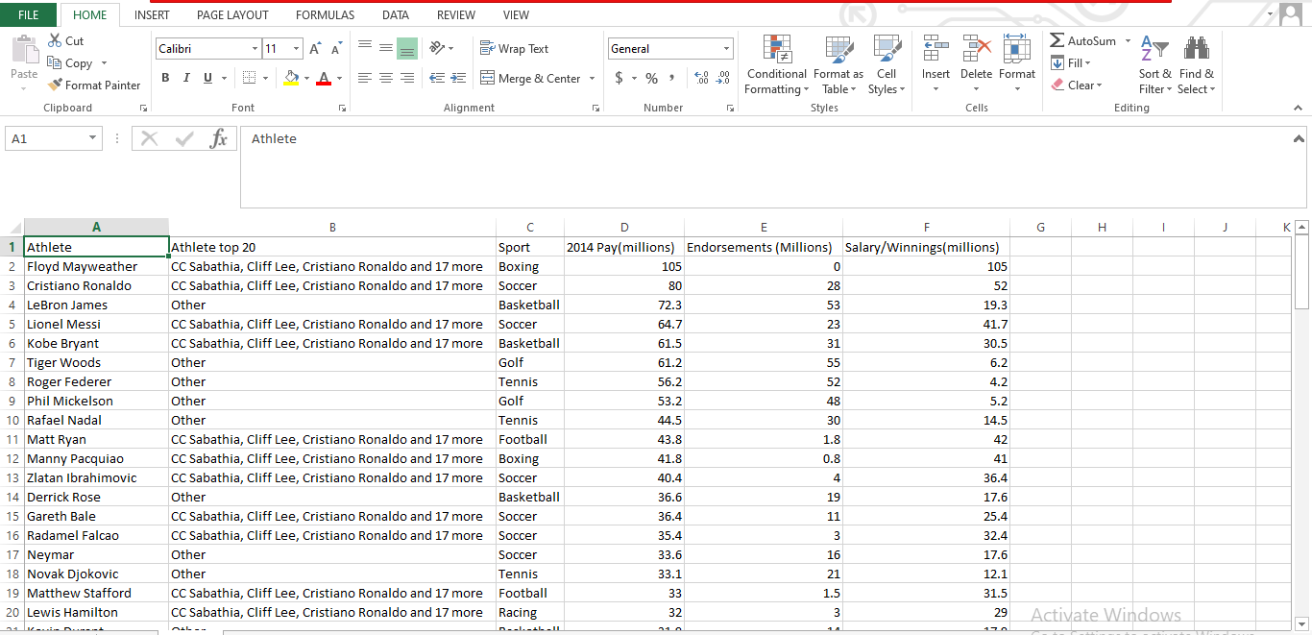

Slide 5
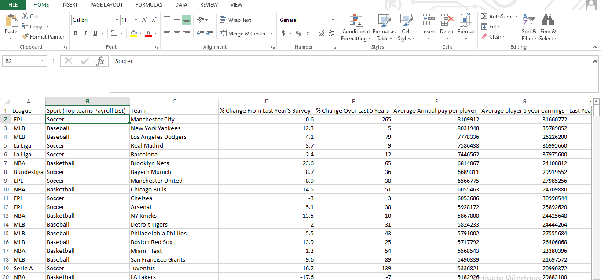

Slide 6
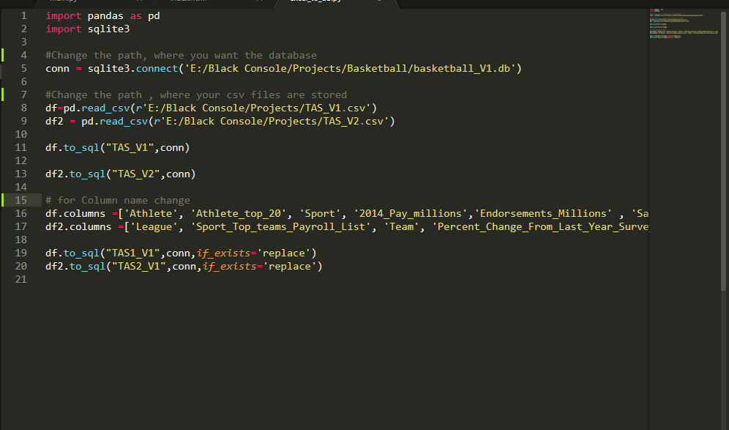
First, I insert the data of csv files into sqlite using python, screen shot is given below:

Slide 7
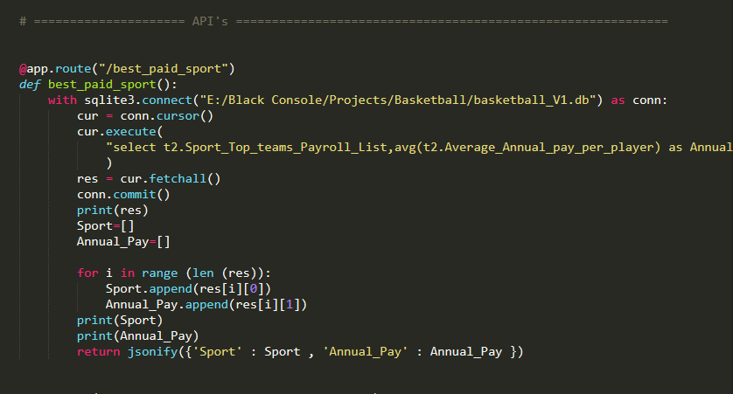
Then, I make the rest Api's in flask .
1st API for Best Paid Sport is as following:

Slide 8
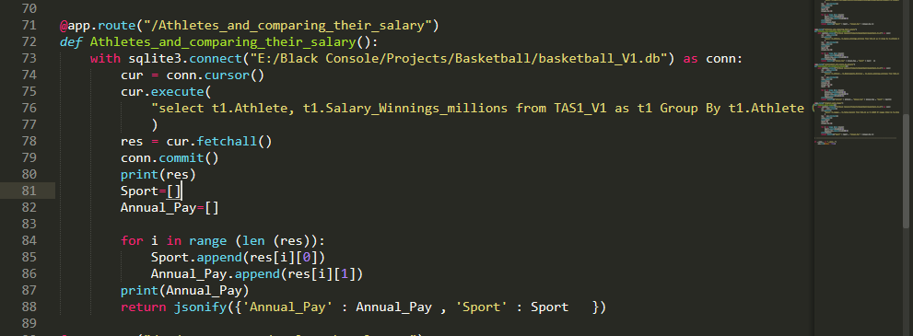
Second API for Athletes and comparing their salary is as following:

Slide 9
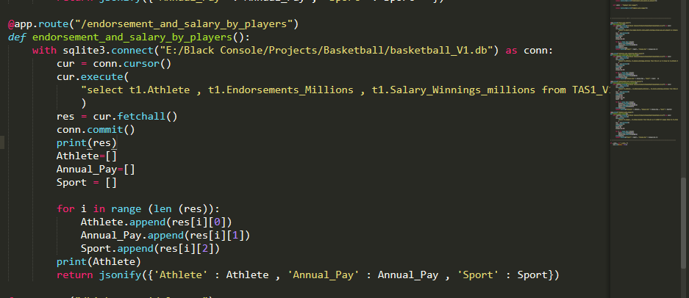
Third API for endorsement and salary by players

Slide 10
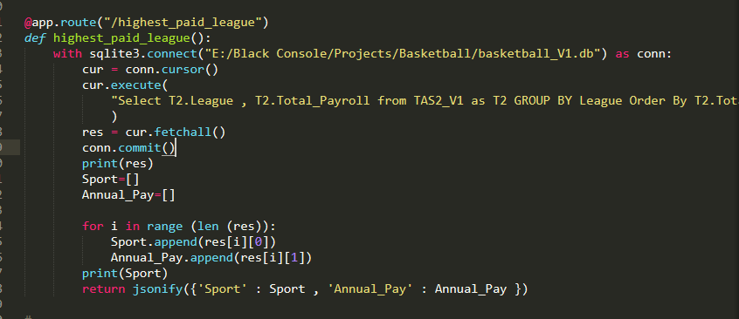
And the fourth API for highest paid league

Slide 11
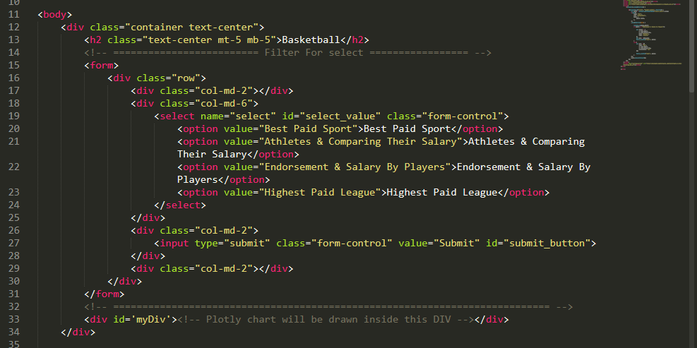
After API's, I created a index.html file for display the charts

Slide 12
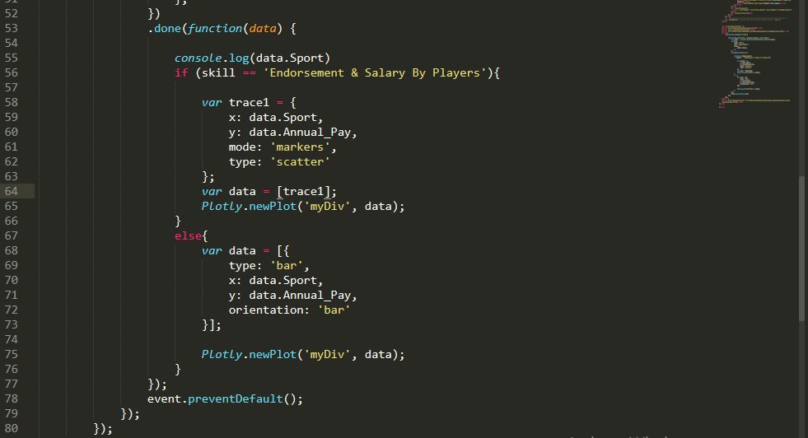
Then, I write js code to make the chart using API's

Slide 13
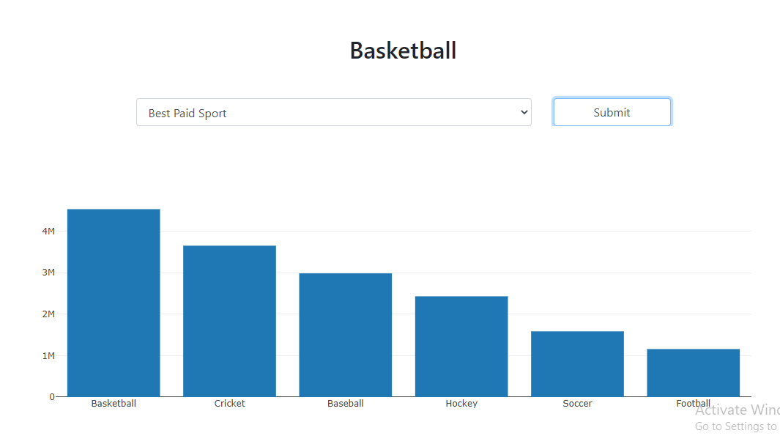
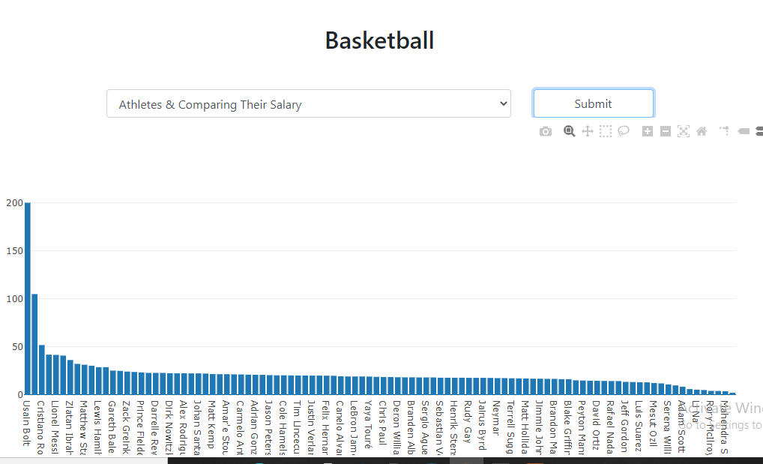
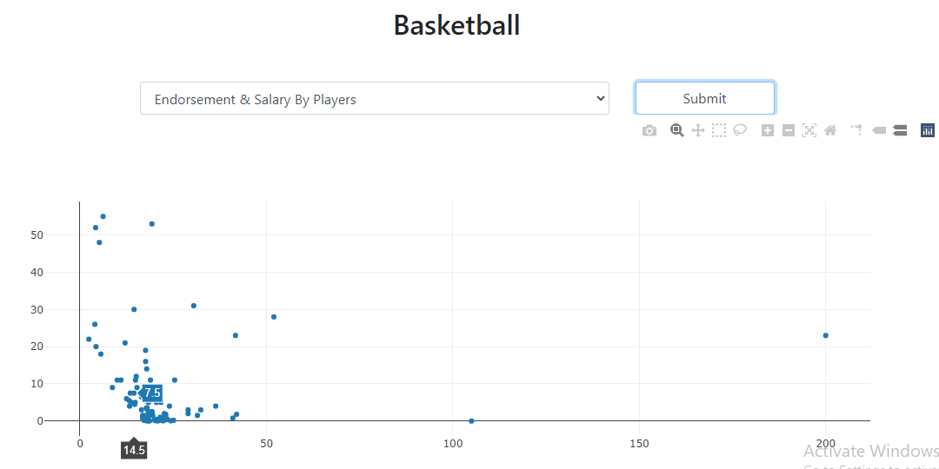
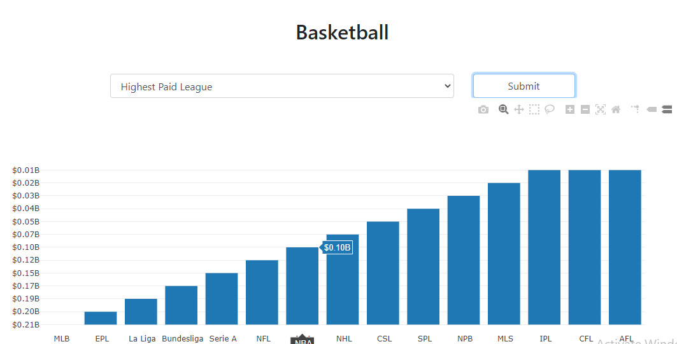
The Output:

Slide 14
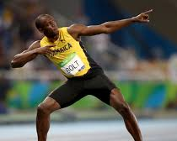
Usain Bolt . Greatest sprinter
Usain Bolt from my analysis is the most paid yearly compared to the other athletes

Slide 15
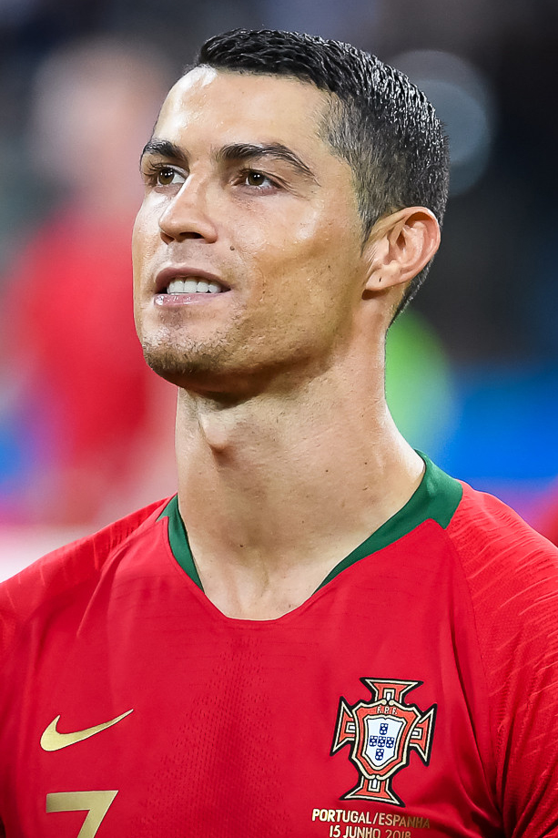
The results of our Analysis
As per soccer,
, Ronaldo Cristiano from Portugal was the most earned Athletes with an annual salary of 52 million compared to Gareth Bale who plays for premiere league and made 25 million per year

Slide 16
Results
The Australian Football league was the most paid league (AFL) compared to the
English premier league which was the least paid
Basketball was the most paid sports compared to football.

